Slide 1

Bootcamp Evaluation Project
FIND THE BUGS & LOOPHOLES

Slide 2
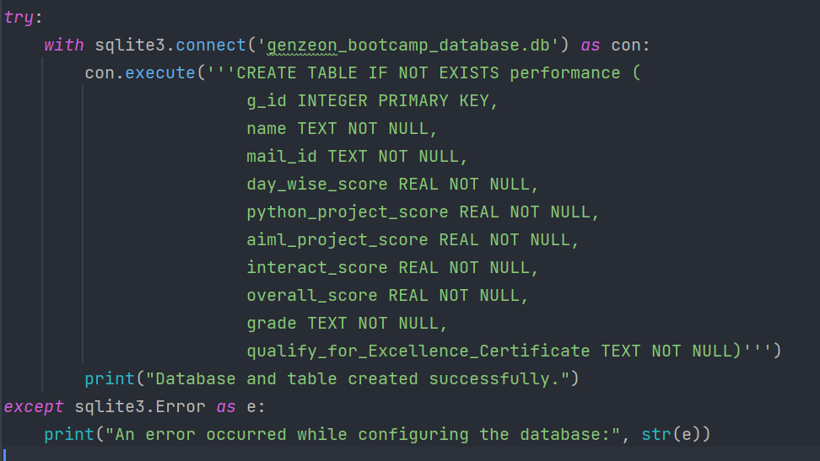
ERROR HANDLING IN Configuration

